Slide 1
TIES4911 - Task 1
Kumpulainen Samu

Slide 2
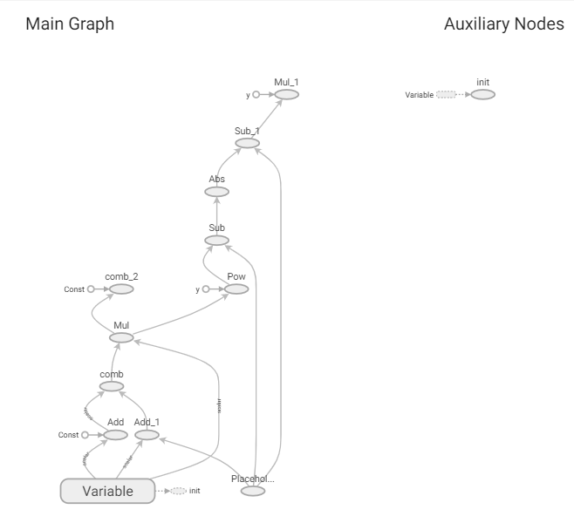
Task 1.1
This graph consists of multiple operations:
Add
Substract
Multiply
Power
Abs
Inputs are a constant, a variable, and a placeholder for value to be added later
Done on Google Colab, see source at: JYU-mail access only

Slide 3
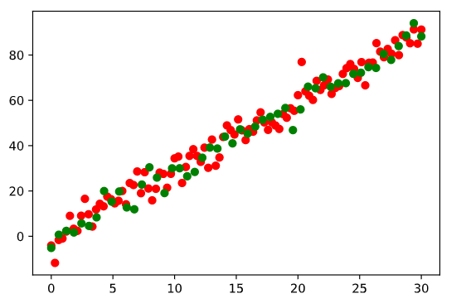
Task 1.2
Generated toy dataset with 100(+50 test) items
Points 0-30, with w = 3, b = 4, test y axis points have some random deviation added
Each model run with 300 epochs
Models were:
Simple Linear Regressor
Estimator LR
Scikit LR
Keras LR
Code found on the same Google Colab with JYU-only access
Test data with 100 items (red) and 50 extra test items (green)

Slide 4
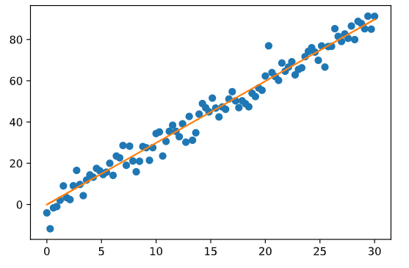
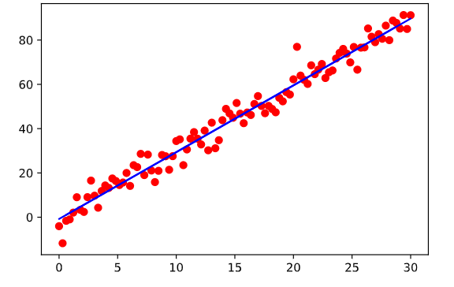
Comparison
Some predictions were made with small set with x being [0, 0.7, 5, 12]
SLR: cost =9.7899 w=2.9877 b=0.0635
-0.04, 2.05, 14.91, 35.86
ELR: average_loss = 19.025517
2.64, 4.60, 16.67, 36.30
SCIKITLR:
-0.79, 1.32, 14.30, 35.41
KLR: MSE: 9.093031883239746
-1.49, 1.14, 15.76 , 36.93
Model had 3 layers
Overall, each Linear Regressor did fine, getting the accuracy data was not easy on every solution though.
Simple
Scikit

Slide 5
Thoughts
Shaping input data was difficult on some solutions, like scikit. On the other hand scikit was easily the easiest model to create. Simple LR was the most difficult and time consuming, mainly because of the variables, their shape and initialization.

